Slide 1
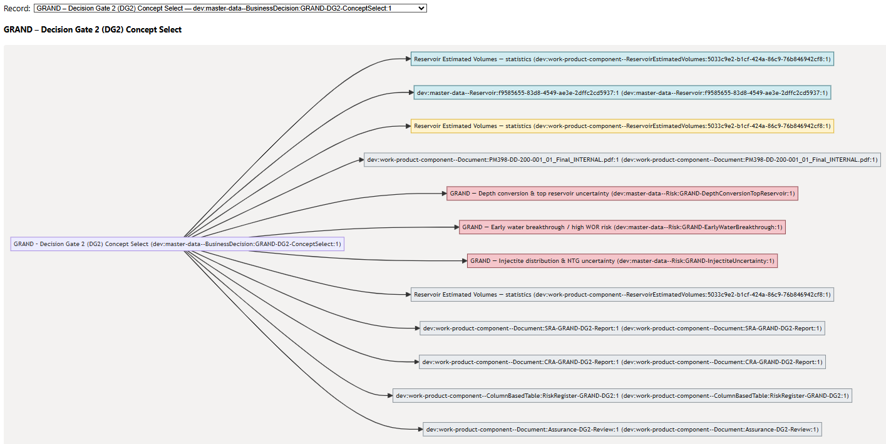
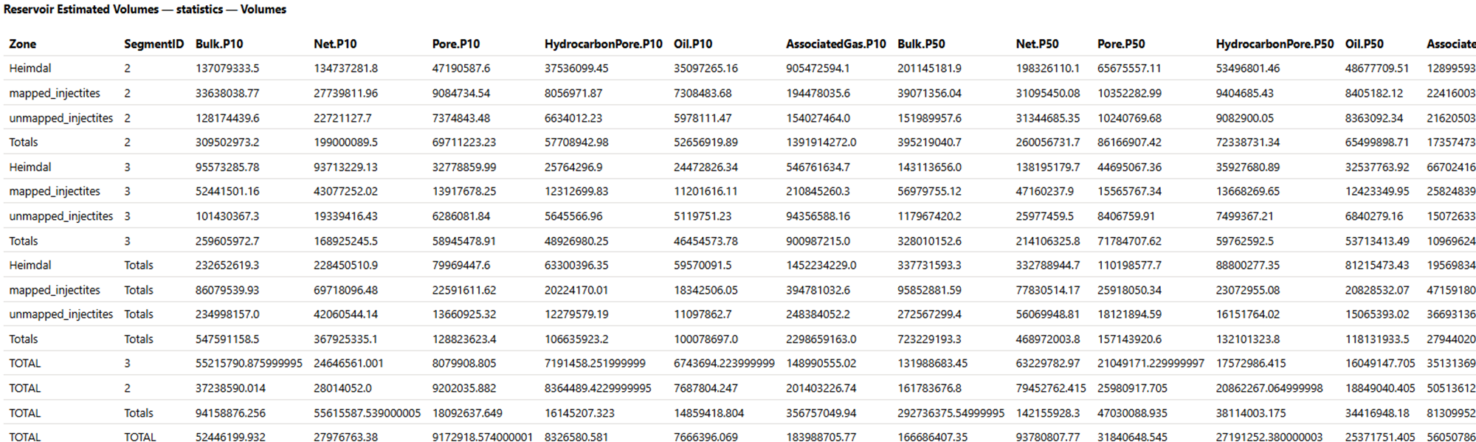
DG1-DG2-DG3-DG4 as OSDU BusinessDecision Proof of Concept Demo Grane GRAND DG2
maap@equinor.com

Slide 2
Why OSDU for DG1–DG4 Decision Traceability
Performance Tracking
Pre-DG1 volumes/inputs stored in GeoX ☺
Post-DG1 issue: No standardized, searchable archive between DG leads to data silos, loss of links, no query, no analysis.
Goal: Be able to compare volumetric estimates across DG1–DG4 and attribute changes to input parameters. Facilitate performance tracking and maturation analysis. What changed between DG?
How? Lossless, formalized input & output records (incl. references) for each DG through OSDU.
Uncertainty Calibration
Use outputs to discover data relationships; refine input distributions for improved future field development decisions.
Why changes between DG?
Risk Governance
Link risks and mitigations to decisions for audit readiness.
System of Record
Package volume tables, design matrices, assurance documents under BusinessDecision. Reference to decision data (e.g. Reservoir DDMS DataSpace with FMU input/output, PersistedCollection with interpretation data = DSG iset, …)
Allow for rich queries and AI analysis.

Slide 3
OSDU Uncertainty and volumetric data: building blocks
Master‑data, unique valid keys for all DG
master-data—Reservoir: reservoir entity of interest.
master-data--ReservoirSegment — segments under the reservoir (compartments like fault block, zone, fluid region) (WPC are linked by ParentObjectID to Field/Reservoir/ReservoirSegment)
Reference‑data, examples for canonical types:
Units: reference-data--UnitOfMeasure (e.g., m3, Mm3).
Statistics facets: reference-data--FacetType:statistics, reference-data--FacetRole: {P10,P50,P90,ArithmeticMean,Minimum,Maximum,StandardDeviation}.
Canonical volume property types: reference-data--ReservoirEstimatedVolumePropertyType: {Bulk,Net,Pore,HydrocarbonPore,Oil,AssociatedGas}.
Work Product Components (WPC), derived objects per DG
Design Matrix, Time series etc.: work-product-component—ColumnBasedTable (generic object in OSDU).
Spatial data: grids, properties, as WPCs (e.g., GenericRepresentation: STOIIP 2d grid map).
Output volumes: work-product-component--ReservoirEstimatedVolumes, raw per‑realization and aggregated statistics
Activity: Use Parameters[] with ParameterRole {input, output, context} to record run inputs/outputs and workflow context, semantics.
Collections for DG input/output/scenarios/cases
WorkProduct: covering versioned package: yearly revisions, PUD, DG … (design/input, Activities, outputs).
CollaborationProjectCollection: curated working set while iterating.

Slide 4
BusinessDecision
OSDU Schema E-R/master-data/BusinessDecision.1.0.0.md
Applicable to field development decisions
Rich in metadata and references to decision foundation, e.g.:
Via these, we can access e.g.:
DecisionLevelID | Reference to DG level (DG1 … DG4)
ApprovalStatusID | Approved, ApprovedWithChanges, Rejected
RiskIDs | List of linked, types Risk records
PriorActivityIDs | Reference to workflow/CVP artefacts (e.g., volume stats)
Parameters[] | Detailed provenance of inputs, and context
ReservoirEstimatedVolumes | Volumetric outputs (raw and aggregated)
ColumnBasedTable | Input parameters/design matrix, output QA tables
Document | Model reports, QA reports, risk mitigation plans, …
GeoLabelSet | Dashboard-friendly headline values, fast discovery tied to master data objects

Slide 5
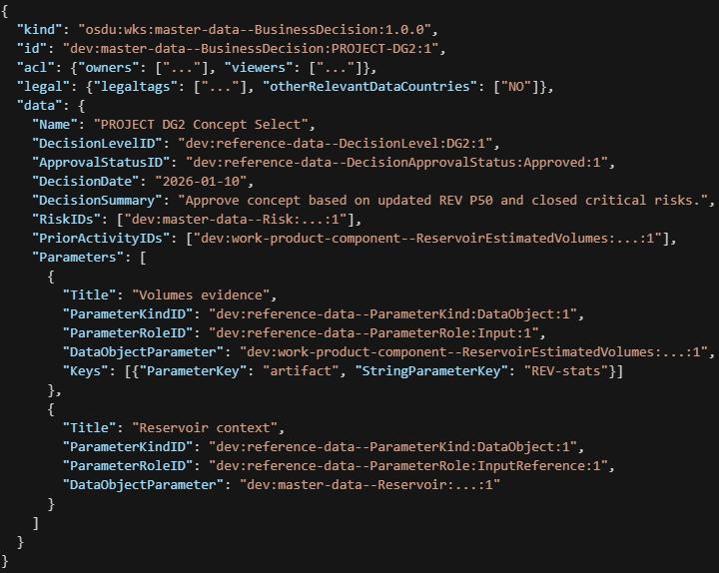
BusinessDecision minimal example

Slide 7
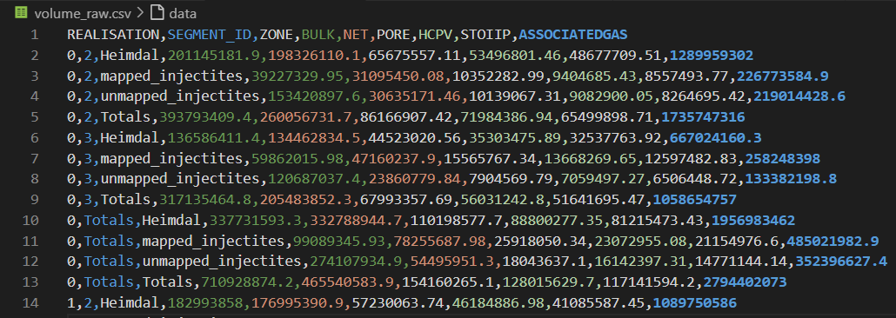
Input: Parameter and volume tables from subsurface modelling
Example: Grane Grand DG2 FMU/RMS run volume table as csv

Slide 8
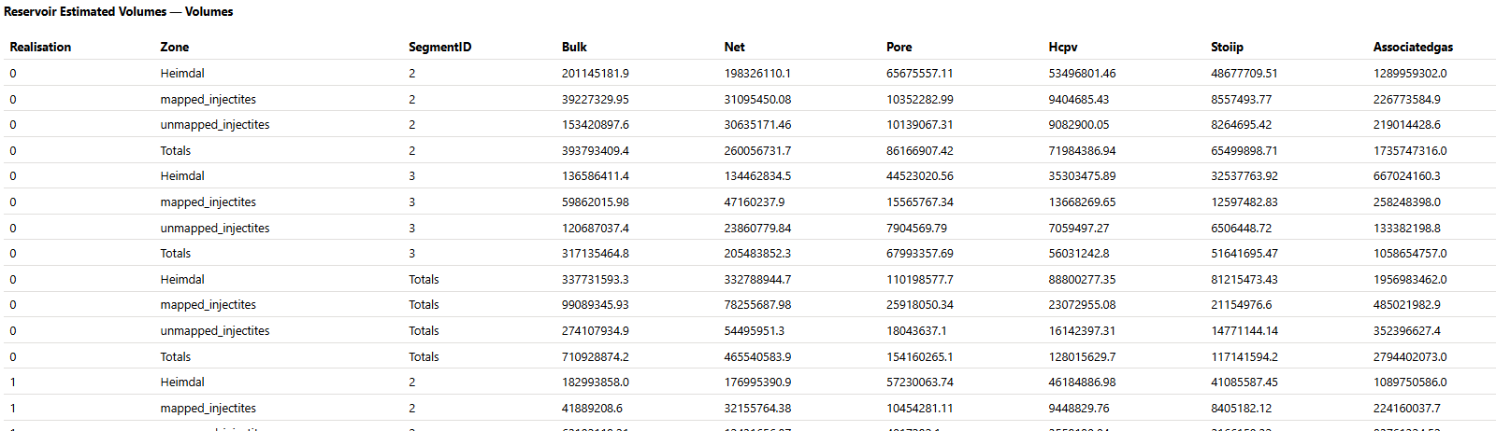
ReservoirEstimatedVolume record for ensemble output volume table
Raw volume table, assigned to MasterData objects.
KeyColumns: Realisation:int, Zone:string, SegmentID:string with KindID = osdu:wks:master-data--ReservoirSegment:2.0.0 — this ties each row to a segment
Uses OSDU canonical reference units, property types , statistical facets. Open governance: extensible – used to add to OSDU custom properties or statistical measures
Could be linked to input ensemble design matrix: as ColumnBasedTable per Realization. Use Activity to record processing

Slide 9

ReservoirEstimatedVolume table for aggregate ensemble volumes
Raw or aggregate volume table, linked to MasterData objects like ReservoirSegment
KeyColumns: Zone, SegmentID; aggregate across realizations
Canonical names; property types with statistics facets defined as reference data

Slide 10
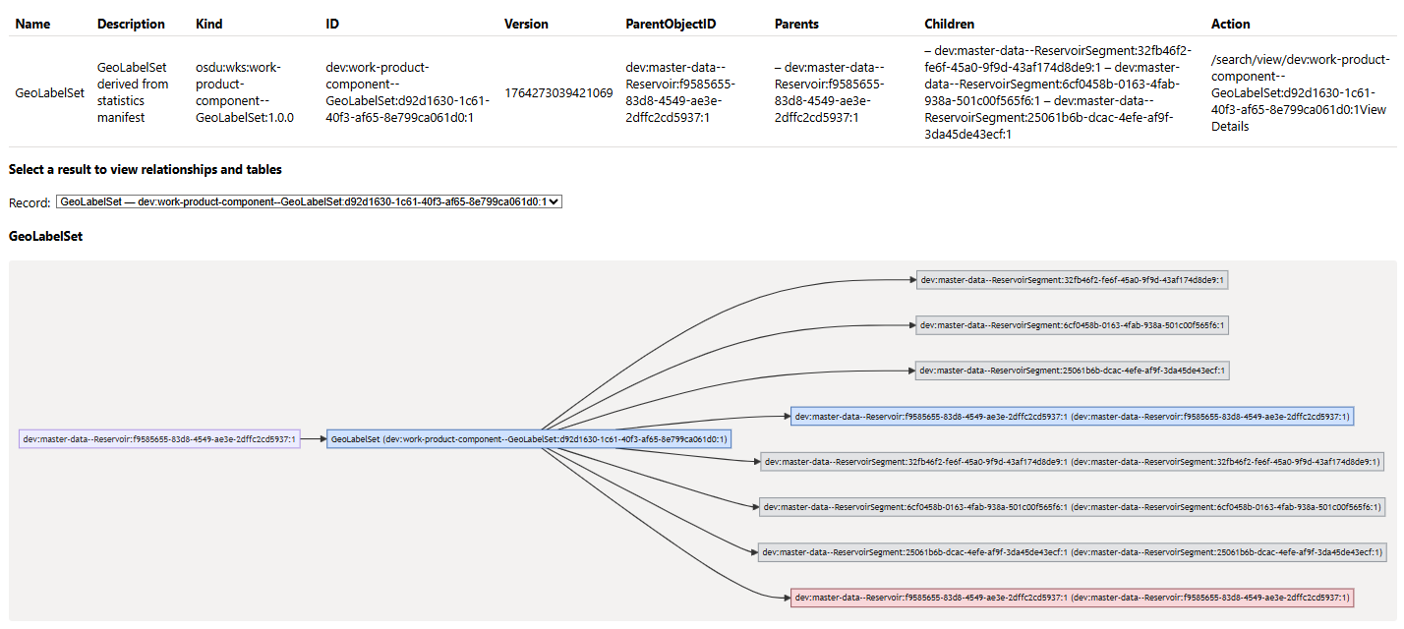
ReservoirEstimatedVolume table – Relationship to MasterData

Slide 11
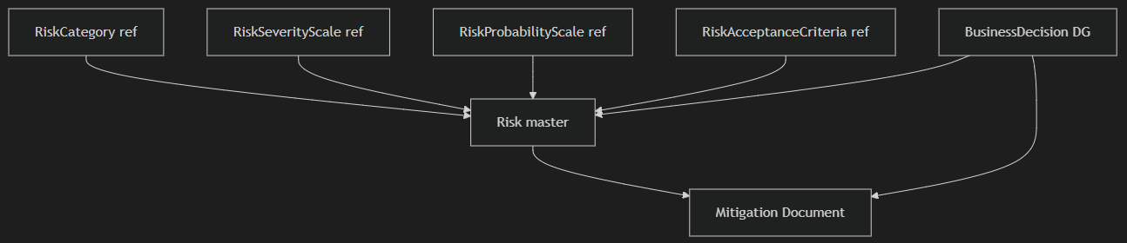
Risk Records using OSDU schema and Equinor canonical types
OSDU Risk Schema E-R/master-data/Risk.1.2.0.md
RiskCategoryID | Classifies risk domain (e.g., Subsurface-Static)
SeverityScaleID | Links to severity scale reference-data
MitigationActionIDs | References Document WPCs for mitigation

Slide 12
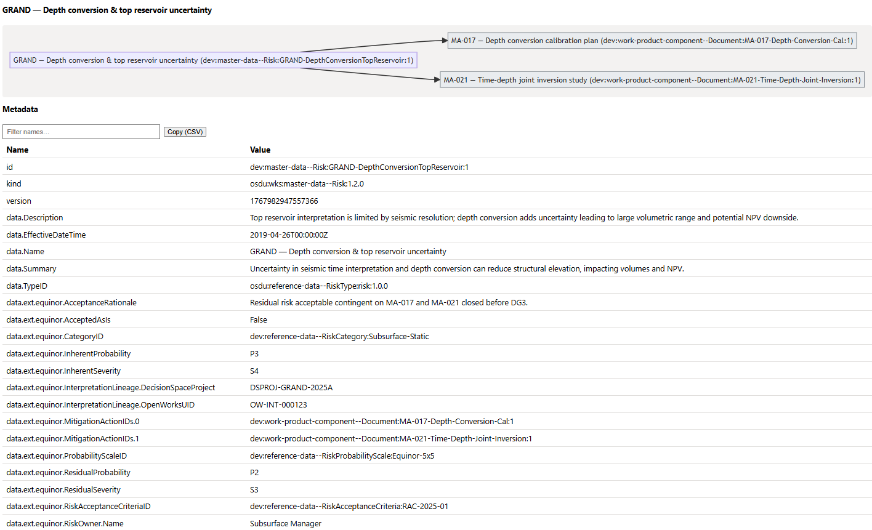
Risk Example

Slide 13
Convenience Schema: GeoLabelSet
assign arbitrary properties (e.g. volumes, average NTG) to master data objects such as ReservoirSegment

Slide 14
Query Decisions and Evidence to improve future uncertainty parametrization, risk mitigation, and decisions
BusinessDecision by DecisionLevelID | Retrieve all DG2 decisions
Join volume or property stats across gates | Compare volumetric evolution, analyse (AI?) uncertainty distributions/ granularity/maturation to detect deficiencies
GeoLabelSet by LabelledEntityID | Display property dashboard metrics related to master data elements
RiskIDs join Risk records | Assess residual risk and mitigations
Realisation | keeping provenance tight, Join on keys, Realisation input ↔ output (ensemble MC/ED matrix)
Activity | Activity carries both the design row and the volume output with the same realisation-index key in Parameters[]; records i/o and workflow processing
Case binding | WorkProduct/Collection id referenced as context to bind the scenario.

